Slide 1
ETL Project – Overview, Extract and Transform Process
Kaggle Dataset : Death in the United States data from Centers for Disease Control and Prevention
https://www.kaggle.com/cdc/mortality
Death statistics for years 2005 through 2015, associated disease/death codes
Data file for each year contains approximately 2.5 M rows as CSV
Each year has JSON file with code keys and values that map to subset of columns in the data
ETL exercise is to extract the data, design an accommodating database schema, push to the database
Extract Process
Data was downloaded as a .zip file and extracted into a data directory
Use JSON module to read each into a corresponding dictionary
Use Pandas to read each data .csv file into a data frame
Transform Process
Confirm data in JSON files are can be combined into a single set of codes applicable to all the data
Analyzed the differences between JSON files and determined all differences are mostly changes in whitespace (spaces) in the descriptions and typo corrections.
Small number of additions of new codes, no deletions.
Wrote functions to confirm all known differences between JSON files in order to detect potential future changes to the data sets
Conclusion is JSON data for year 2015 is super set of codes applicable to all data files
Data files
As files are quite large designed process to control number of rows read in
Established a dictionary object to control what columns to keep and establish fill values for Nan
Wrote function to check columns for all data sets are equivalent and code keys correspond to a column in each data set

Slide 2
ETL Project – Load Process
Load Process
Schema
Schema will have a table for each set of codes from JSON files
As there are 33 sets of codes, we selected 4 code sets for this project
Foreign keys are created to map code values in data tables to rows in respective code table that contains the code description
See Schema diagram below
Database
Database engine used is MySQL, local host
Python interface is SQLAlchemy for engine, pymysql module for queries
Load Codes
To facilitate load of JSON dictionaries, codes are converted to Pandas data frame, then Pandas “to_sql” is used to load table
Load Data
As data is already in a data frame, use Pandas ”to_sql” to load the data.
As the number of rows is large, define a row count for block size and chunk size.
Loop for each block of rows until end, use chunk size as parameter to “to_sql”

Slide 3
ETL Project – Files
File sets
Data Prep file:
Read of JSON file and coherency checks on the data
Main file:
Uses the files above to perform the full ETL operation:
Loading files
Comparison of JSON mapping files
Cleanup and and verification of data file validity ( no invalid codes )
Creation of the database tables
Loading of database tables.

Slide 4
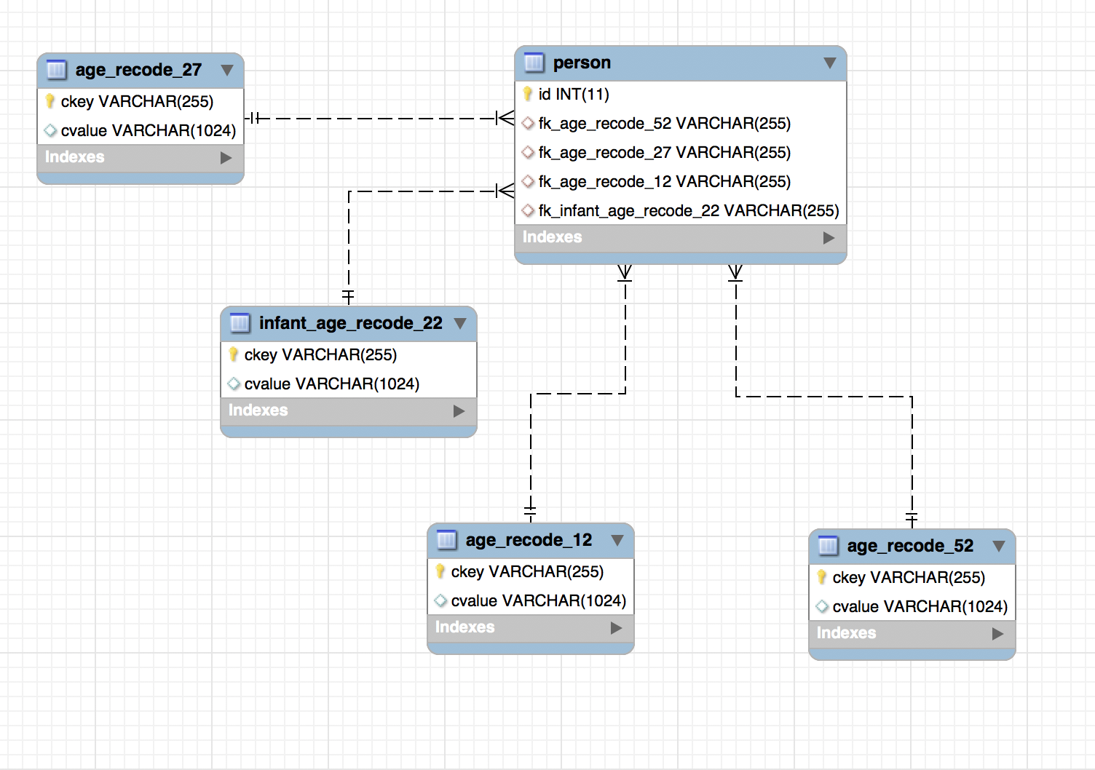
ETL Project – Schema Diagram
(4) Age recode tables represent the selected columns from the json file.
The ‘person’ table represents the data (originally as csv file), it contains the codes that map to a value.

Slide 5
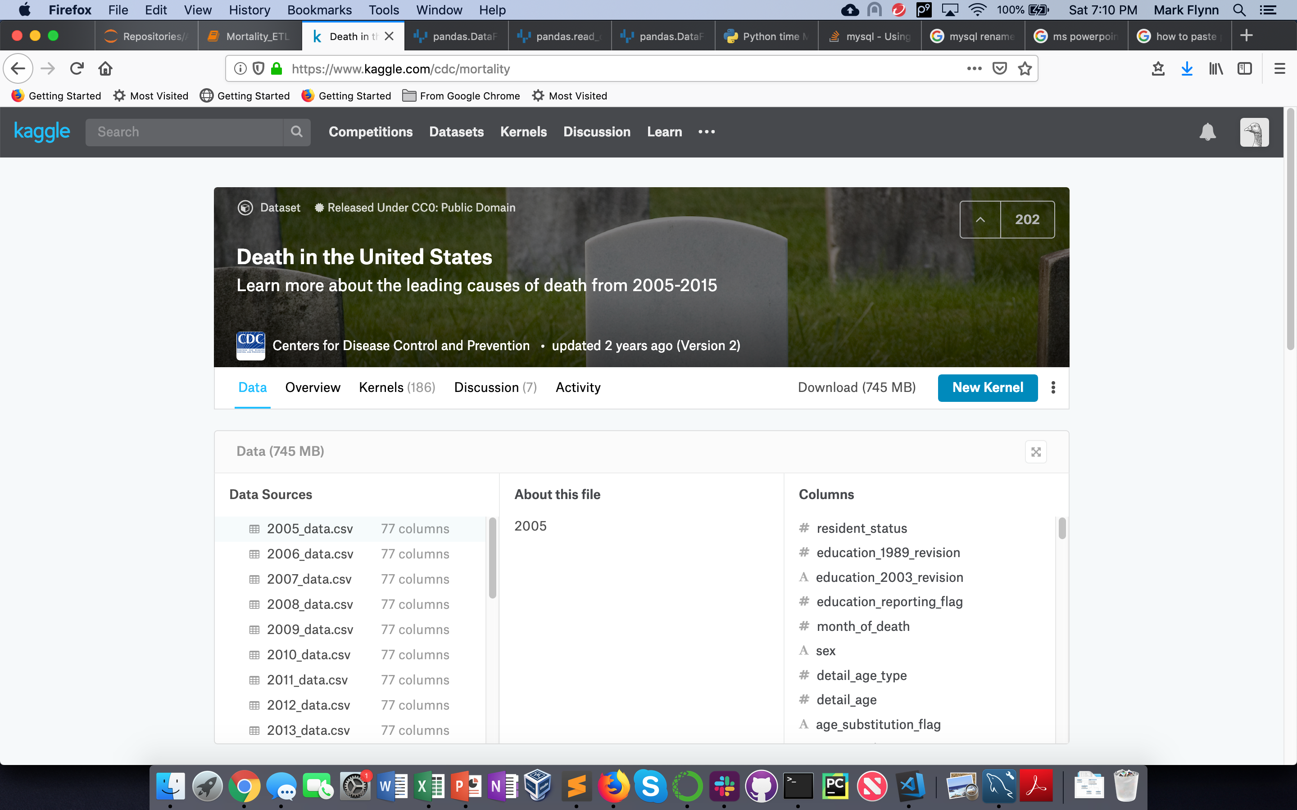
ETL Project – Schema Diagram

